Slide 1

Multi Tenant Security Architecture for Big Data Systems
Suresh Yadagotti Jayaram
Sr. IT Technical Architect

Slide 2
What is Big Data
“Big Data refers to datasets whose size and/or structure is beyond the ability of traditional software tools or database systems to store, process, and analyze within reasonable timeframes”
HADOOP is a computing environment built on top of a distributed clustered file system (HDFS) that was designed specifically for large scale data operations (e.g. MapReduce)

Slide 3
Pre-Cursor
Reasons for securing data in Big Data systems
Subject to Regulatory Compliance
Business Enablement
Contains Sensitive Data
Teams go from a POC to deploying a production cluster, and with it petabytes of data.
Contains sensitive cardholder and other customer or corporate data that must be protected
Usage was restricted to non-sensitive data
Allow access to restricted datasets with Security
Compliance to PCI DSS, FISMA, HIPAA, federal/state laws to protect PII

Slide 4
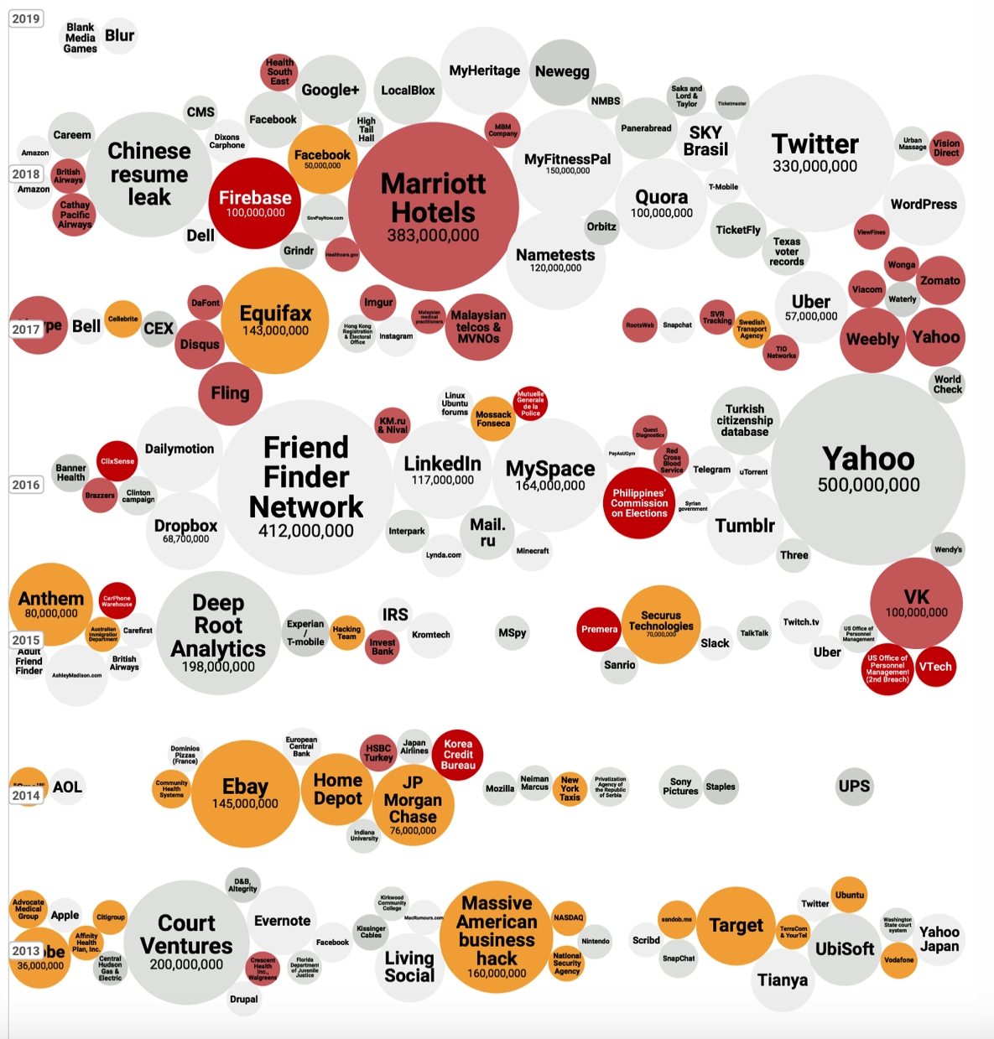
Data Breaches & Hacks
Different kinds of PII, financial data, and IP breached. Healthcare, Retail, Federal Govt., Financial Institutions, Tech companies etc.

Slide 5
Per capita cost – Industry Sector
Certain industries have higher data breach costs. compares 2018 year’s per capita costs for the consolidated sample by industry classification.
As can be seen, heavily regulated industries such as healthcare and financial organizations have a per capita data breach cost substantially higher than the overall mean.

Slide 6
Root Causes
27%
Human Errors
48% Malicious or Criminal Attack
25%
System glitch

Slide 7
Goals of an Attacker
01
02
03
The primary goal is to obtain sensitive data that sits in Organization Databases
This could include different kinds of regulated data (e.g. Payment data, Heath data) or other personally identifiable data (PII)
Other attacks could include attacks attempting to destroy or modify data or prevent availability of this platform.

Slide 8
Threats – Counter measures
Attacker attempts to gain privileges to access data
Unauthorized access
Authentication
Authorization
Auditing
Host Level Data at Rest Attacks
Application Level
HDFS level
File System/Volume level
Types of Threats
Network Based Attacks
Transport Layer Security
SASL Encryption
Infrastructure Security
Automation
SELinux

Slide 9
Security Objectives
Compliance
Best Practices
With regulatory mandate requirements
For securing data technologies
“It’s all about the data.”
Successful implementation of Data Lakes in organizations will demonstrate confidentiality, integrity, and availability across the enterprise.
Alliance
Standards alignment
Contractual Obligations
State of Organization
SOC2/ Type 2 Audit
Evidence of controls

Slide 10
Achieve Secure Data Enablement
By understanding the key criteria:
GOVERNANCE
Knowing what the information is
What is the function of the data?
USERS
Who is using the data?
Who needs what kind of access?
LIFECYCLE
How does information connect across systems?
What are retention requirements for the data?
CONTROLS
Engage early to understand controls complexity
Know the value & risk factors indicated by the data & solutions.

Slide 11
Data level hierarchy & OBJECTIVES
Enterprise Level
Enterpriseis the highest level and any data stored at this level is visible / available for all the tenants (geographical data, code sets, etc.)
Tenant Level
To minimize the impact to the existing legacy systems and home-grown services, we will use the additional attributes like “Tenant ID” and “Data Delimiters” to identify which records belong to which tenant. Members can have multiple records in the same system with different Tenant ID’s in case s/he purchased products from more than one tenant.
Domain Level
Application Layer/Domains to control access and/or capabilities (such as LOB, group, segment, or other data restrictions or classifications) within the tenants they use. Application layer to control what the constituent experiences, what data they can access, and how.
Database/Table
Every data set will include audit attributes such as:
Who is providing the data? ,
What data is being collected ?,
When the data is collected?,
Where the data is collected from?
Why is the data collected ?

Slide 12

Enterprise level objectives
Enterprise Level Data will…
Be visible & available to ALL tenants
Data Classified, labeled, or segregated in a manner that indicates it has been approved for enterprise wide use which may include Geographical data, code sets, etc.
Data Classified as Public
Support both internal and external users depending on classification
Internal users get access through an application Id or directly with User Id

Slide 13
Tenant level OBJECTIVES
Enterprise
Tenant Level Data will…
Support multiple tenants
Be segregated logically (tagged, labeled, or container segregated based on tenant ID or data delimiters, not physically where possible based on controls objectives for organizations
Be co-mingled; all applications are storing data together with the following defaults:
Logical separation when applicable (controlled by Ranger Policies and data object implementation)
Default = Applications (Different Log Locations). Services (Ex; Ranger. Same Log locations).
Use an additional fields: Tenant ID and Data Delimiters
This minimizes impact to existing legacy systems and home-grown services
Tenant IDs and Data Delimiters will be used in tables to identify which records belong to which tenant and Enterprise Line of Business.
Use applications to enforce 100% usage of Tenant IDs and Data Delimiters verified through exceptions, audit & recon

Slide 14
Domain Level OBJECTIVES
Enterprise
Tenant Level
Domain Level Data will…
Control access and/or capabilities within the tenants they use
Include application layer that controls what the constituent experiences or what data they may access
Also controls how the constituent accesses the data

Slide 15
Database Level OBJECTIVES
Enterprise
Tenant Level Data
Domain
Database/Application Level Data will…
ePHI attribute classification and inventory
User Permissions/Authorizations
Include audit attributes that answer the following questions for every dataset:
Who provided the data?
What data was collected?
When was the data collected?
From where is the data collected?
Why is the data collected ?
Data activity monitoring - Who accessed, when accessed, where accessed

Slide 16
Data Handling – Tenant, Domain,
Application, Database, Table (Row & Column) Level
Enterprise
Tenant
Domain/
Application
Create an AD group that includes all users
Resources common across org will be shared across users
Create separate AD groups based on tenant ID; add appropriate users respectively
Data gets comingled from different Tenants; Ranger policies control access
Table - Column
Table - Row
Create separate AD groups for read, read/write, & appropriate users from respectively
There could be multiple applications as part of domain
Data in tables could be categorized based on roles, such as accessing data based on column or row level.
Policies are created for Read and Read/write
Policies are created at Row and Column level
Policies are created to mask sensitive data

Slide 17
Five Pillars of Security
1
Administration
Central Management & Consistent Security
2
Authentication
Authenticate Users and System
3
Authorization
Provision Access to Data
4
Data Protection
Protect Data at Rest & in Motion
5
Audit
Maintain a record of Data Access

Slide 18
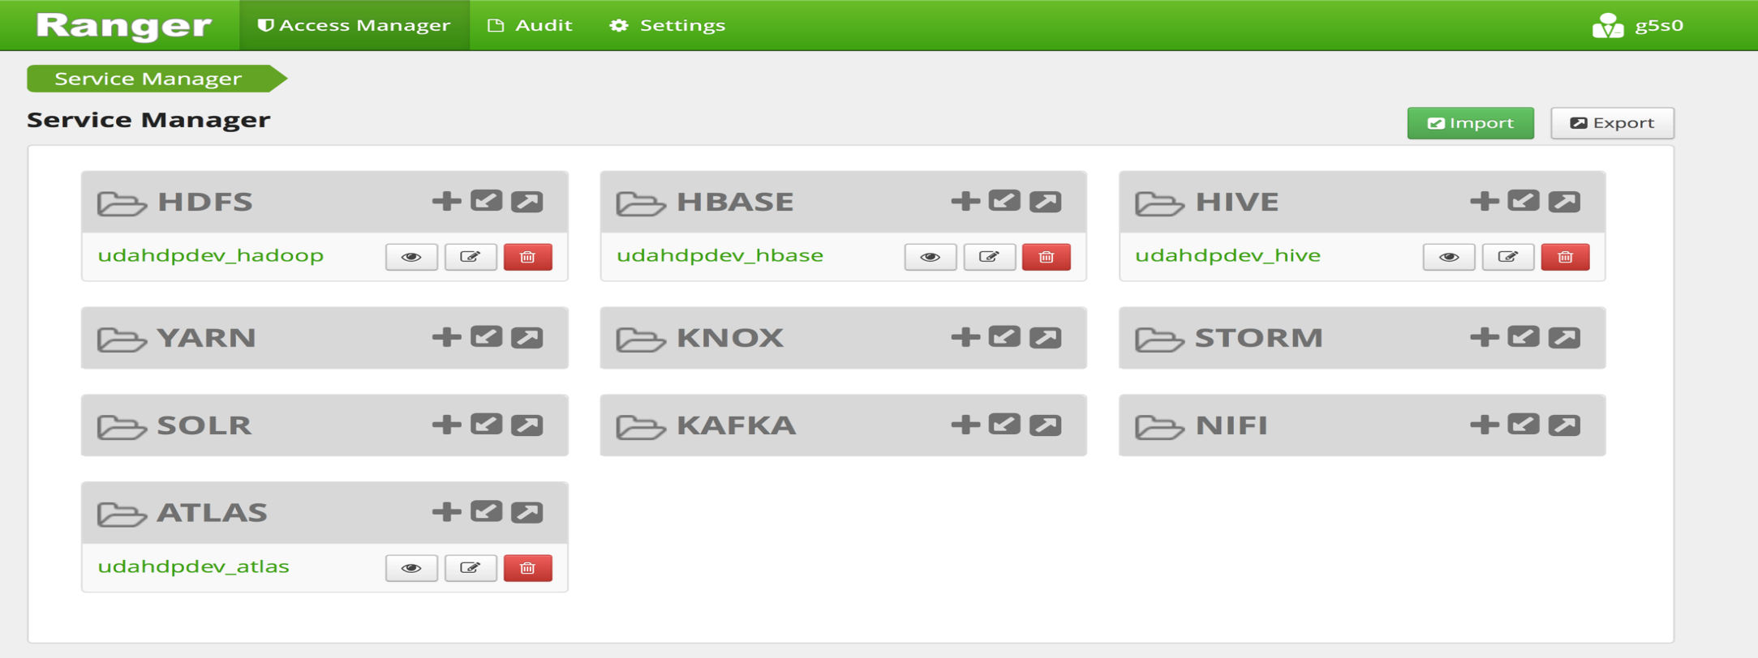
Ranger – Centralized Administration
Central Management & Consistent security
Single pane of glass for security administration across multiple Hadoop Components for Creating, implement, Manage and Monitor Security Policies

Slide 19
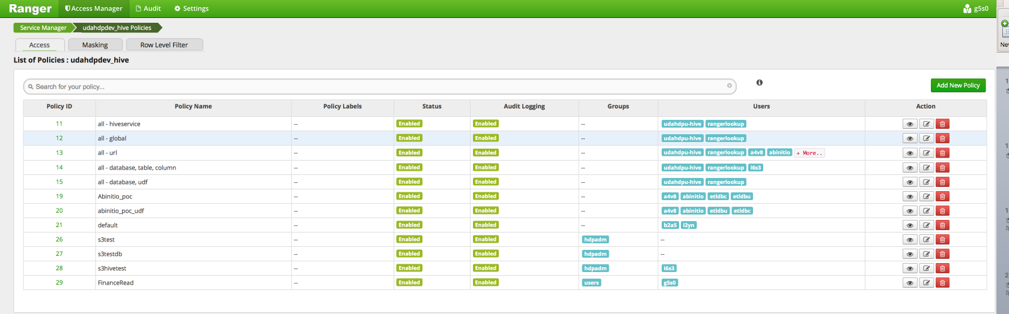
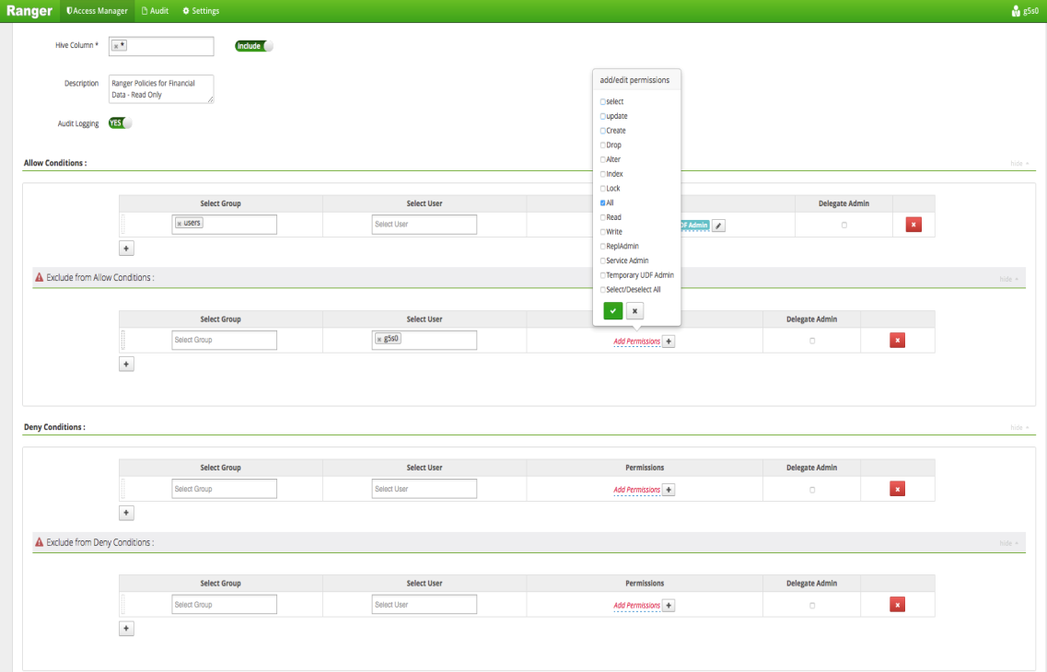
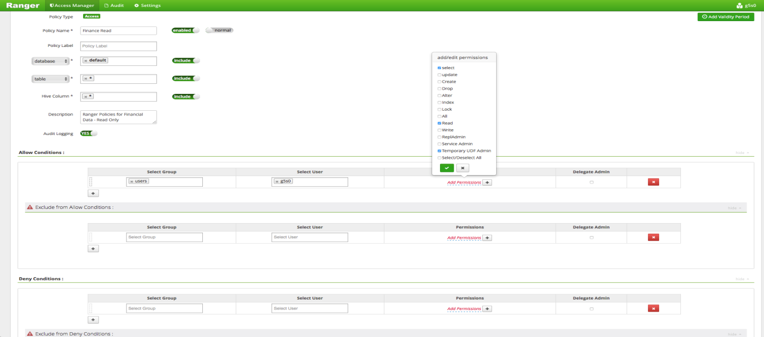
Ranger – Authorization Policies
Consistent authorization policy structure across Hadoop components

Slide 20
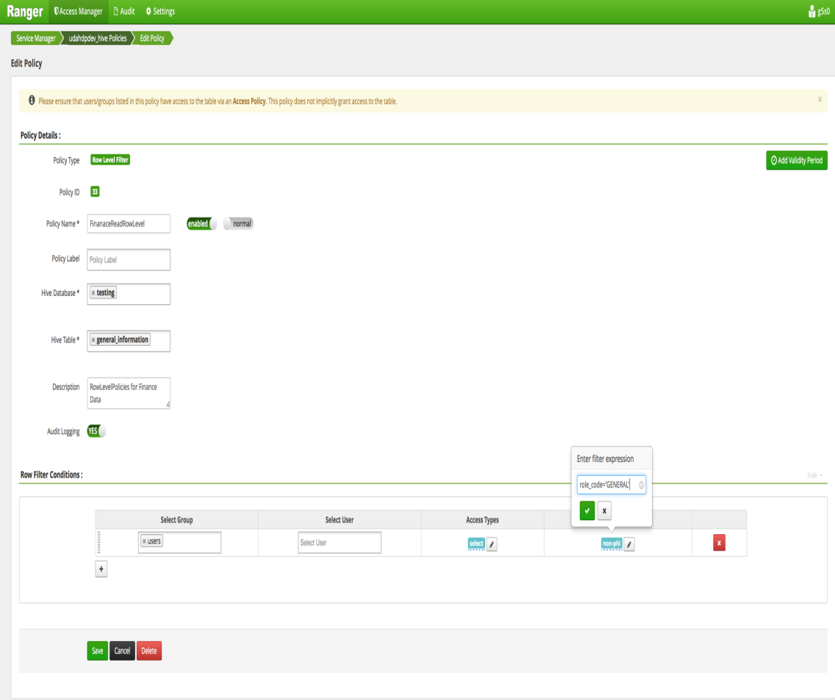
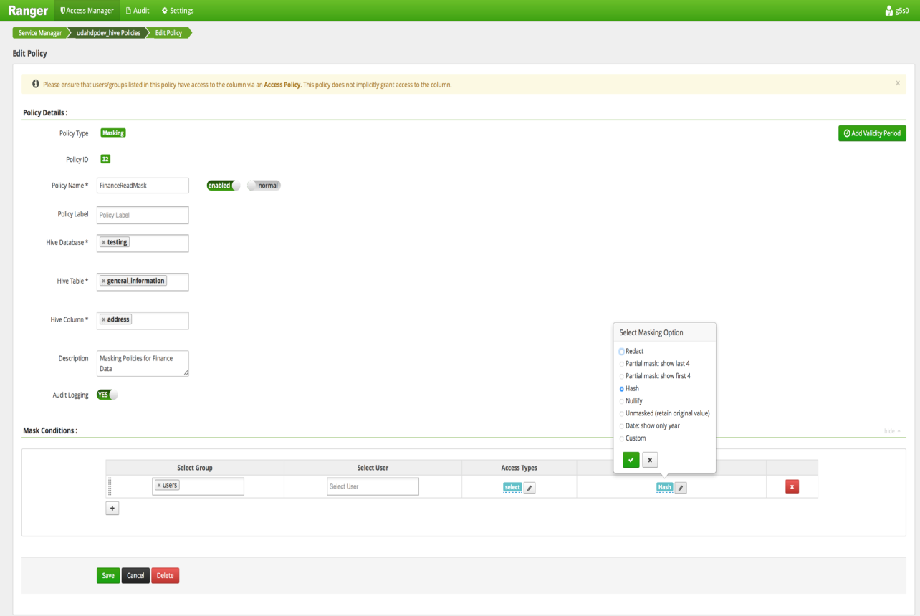
Ranger – Row-filter, Column-masking

Slide 21
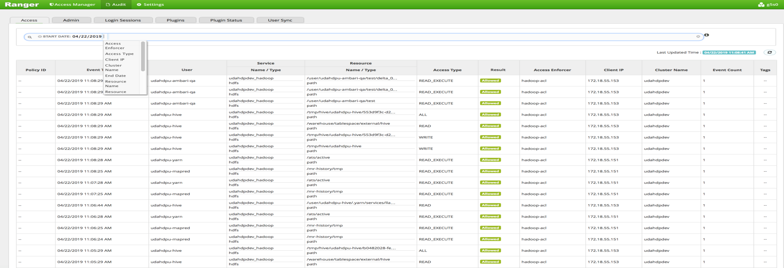
Ranger – Access Audit Logs
Apache Ranger generates detailed logs of access to protected resources
Audit logs to multiple destinations like HDFS, Solr and Log4j appender
Interactive view of audit logs in Admin console

Slide 22
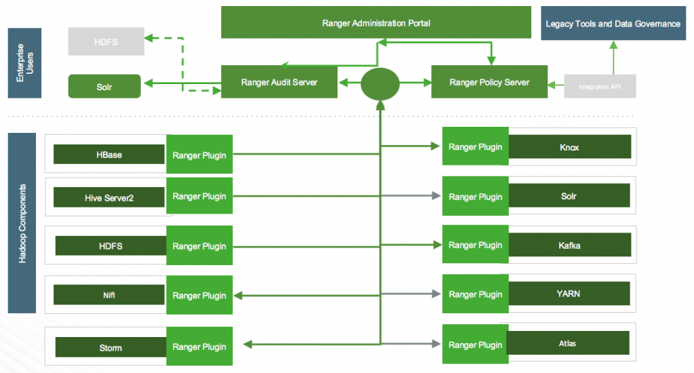
Ranger – Architecture

Slide 23
Questions

